Slide 1

CHAPTER 4
Sample Designs
DISCOVER . LEARN . EMPOWER

Slide 2
INDEX
Sample Designs: Population Sample
Sampling Error
Sample Size
Need of sampling
Characteristics of a good sample
Different type of sample designs

Slide 3
Population
A sample design is a definite plan for obtaining a sample from a given population.
It refers to the technique or the procedure the researcher would adopt in selecting items for the sample.
Sample design may as well lay down the number of items to be included in the sample i.e., the size of the sample.
Sample design is determined before data are collected. There are many sample designs from which a researcher can choose. Some designs are relatively more precise and easier to apply than others.

Slide 4
Sampling Error
Sampling errors are the random variations in the sample estimates around the true population parameters.
they occur randomly and are equally likely to be in either direction, their nature happens to be of compensatory type and the expected value of such errors happens to be equal to zero.
Sampling error decreases with the increase in the size of the sample, and it happens to be of a smaller magnitude in case of homogeneous population.
Sampling error can be measured for a given sample design and size. The measurement of sampling error is usually called the ‘precision of the sampling plan’.
If we increase the sample size, the precision can be improved.

Slide 5
Sample Size
This refers to the number of items to be selected from the universe to constitute a sample. This a major problem before a researcher.
The size of sample should neither be excessively large, nor too small. It should be optimum. An optimum sample is one which fulfills the requirements of efficiency, representativeness, reliability and flexibility.
While deciding the size of sample, researcher must determine the desired precision as also an acceptable confidence level for the estimate. The size of population variance needs to be considered as in case of larger variance usually a bigger sample is needed.
The size of population must be kept in view for this also limits the sample size. The parameters of interest in a research study must be kept in view, while deciding the size of the sample.
Costs too dictate the size of sample that we can draw. As such, budgetary constraint must invariably be taken into consideration when we decide the sample size.

Slide 6
Need of sampling
Resource Efficiency
Time Constraints
Practicality
Infeasibility of Population Study
Destructive Testing
Statistical Inference
Reducing Bias
Accessibility
Ethical Considerations

Slide 7
Characteristics of a good sample
Sample design must result in a truly representative sample.
Sample design must be such which results in a small sampling error.
Sample design must be viable in the context of funds available for the research study.
Sample design must be such so that systematic bias can be controlled in a better way.
Sample should be such that the results of the sample study can be applied, in general, for the universe with a reasonable level of confidence.

Slide 8
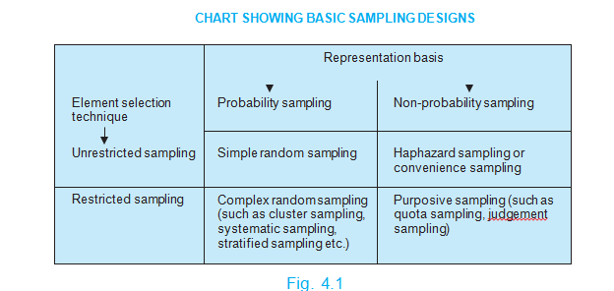
Different type of sample designs

